Slide 1
Unit I: Water Technology Topic: Reverse Osmosis
Dr. P. G. Umape
Assistant Professor
Pune Institute of Computer Technology

Slide 2
Learning outcomes
Students should able to express principle of osmosis.
Student should be able to describe the construction and working of reverse osmosis unit.
Student should give the advantages and limitations of reverse osmosis process.

Slide 3
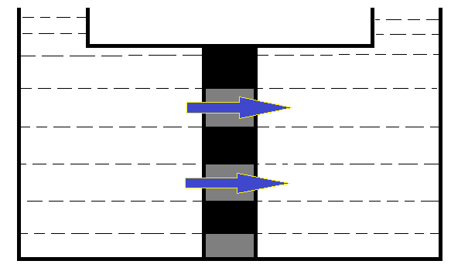
Osmosis
Semipermeable membrane
Solution of low concentration
Solution of high concentration
Flow of Solvent

Slide 4
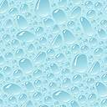
Osmosis
Semipermeable membrane
+
-
+
-
+
+
-
+
-
-
-
+
-
+
+
-
+
-
+
-
-
-
-
+
+
+
+
-
-
-
+
-
+
-
+
-
+
+
+
-
-
+
+
-
Solution of low concentration
Solution of high concentration

Slide 5
Osmosis
Osmosis is a spontaneous process
When two solutions of different concentration are separated by a semipermeable membrane then solvent flows from low concentration to high concentration through semipermeable membrane to achieve osmotic equilibrium, this process is called as osmosis.
The force which makes solvent flow from low concentration to high concentration is called osmotic pressure.

Slide 6
Semipermeable membrane
Semipermeable membranes are the one which allows certain molecule or ion pass through it.
Flow of other molecule or ion is restricted by the membrane.
Permeability of these membrane depends on pore size, pressure, temperature, solubility, chemical nature of molecule/ion/solvent.
They may be natural(phospholipid) or synthetic (polyamide polymer).

Slide 7
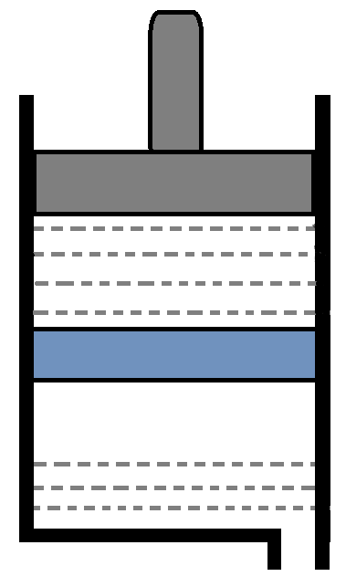
Reverse Osmosis
Diagram:
Piston
Hard water
Semipermeable membrane
Soft water

Slide 8
Reverse Osmosis
+
-
+
-
+
+
-
-
+
-
+
-
Semipermeable membrane

Slide 9
Reverse Osmosis
Reverse osmosis is a process in which water is forced to flow from higher concentration to lower concentration through semipermeable membrane by applying pressure on concentrated water. The applied pressure is higher than osmotic pressure.

Slide 10
Reverse Osmosis
Construction:
It consist of a tank having two chambers, separated by semipermeable membrane.
The semipermeable membrane is strong enough to withstand high pressure.
Upper chamber is provided with a piston to apply pressure on hard water.
Soft water is collected in lower chamber

Slide 11
Reverse Osmosis
Working:
Hard water is filled in upper chamber
Pressure is applied on hard water with the help of piston
Applied pressure should higher than osmotic pressure
Here water flows from upper chamber to lower chamber through semipermeable membrane.
The soft water is collected in lower chamber will be free from all ionic, suspended and colloidal impurities, but it needs sterilization to remove biological impurities.

Slide 12
Reverse Osmosis
Advantages:
By this process all the ionic, non-ionic, colloidal impurities can be removed.
The membrane have long life and only membrane needs to be changed hence low maintenance cost.
Easy to operate, requires small space
The process can be used for desalination of water
Hardness up to zero ppm can be achieved.

Slide 13
Reverse Osmosis
Limitations:
Water needs to be pre-treated so as to remove colloidal and suspended impurities, as they may choke membrane.
Purified water may consist of biological impurities hence sterilization of water is needed.

Slide 14
Summary
What is osmosis
What is semipermeable membrane
What is osmotic pressure
Principle of reverse osmosis
Advantages, limitations of Reverse Osmosis process

Slide 15
Thank You
Thank You

